Slide 1
Capstone Design
Team 3
20163704
20161344
20164245
Park JuHyeon
Heo JeongWoo
Hong Jin

Slide 2
Contents
1.
Feedback
Progress
Schedule
Q&A
2.
3.
4.

Slide 3



♥
Project Introduction
Smoothie
person
Input
Output

Slide 4
1.
Q&A Feedback

Slide 5
1
Q&A Feedback
Feedback
Synchronization and usability when Using Modal
We provide convenience while using the main page as much as possible.

Slide 6
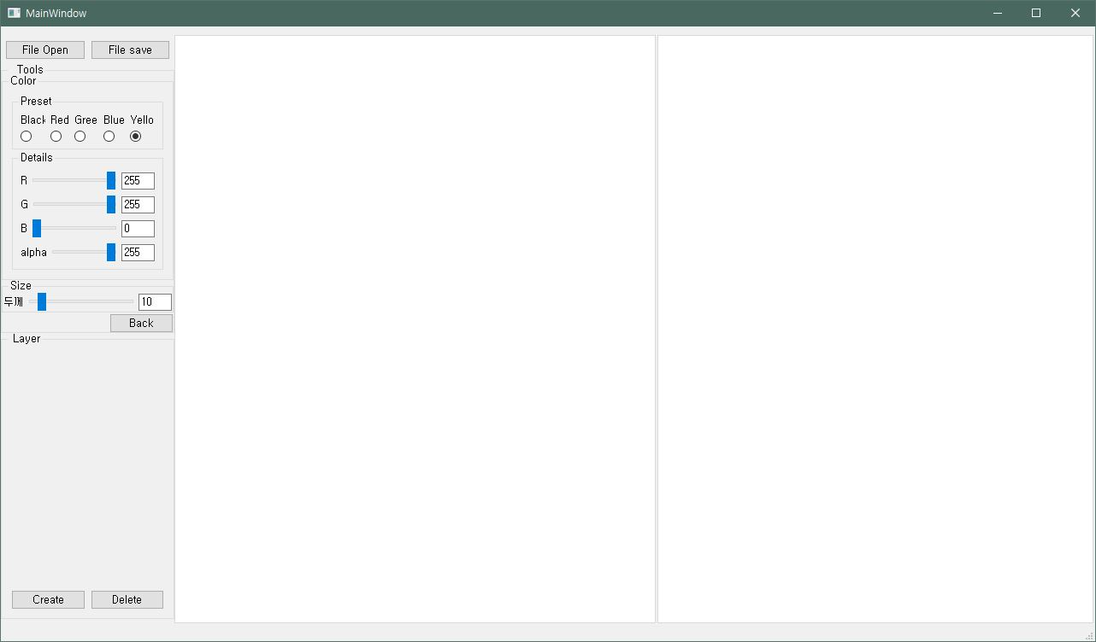
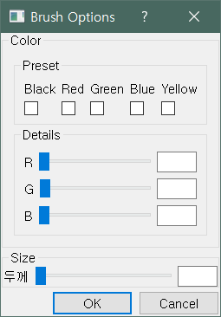
1
Q&A Feedback
Feedback

Slide 7
1
Q&A Feedback
Feedback
Project Outline in front of the presentation

Slide 8
2.
Progress

Slide 9
2.1
Collect Test Image & Learning

Slide 10
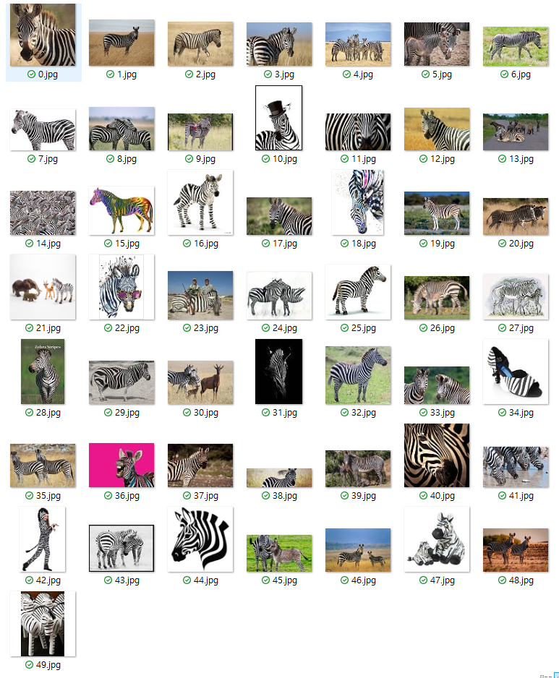
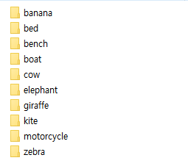
2
Progress
Test Image – Park Juhyeon
Collect Test Image
60 categories, 3000 images

Slide 11
2
Progress
Test Image – Park Juhyeon
40 categories, 2000 images
60 categories, 3000 images
(Until 80 categories, 4000 images)

Slide 12
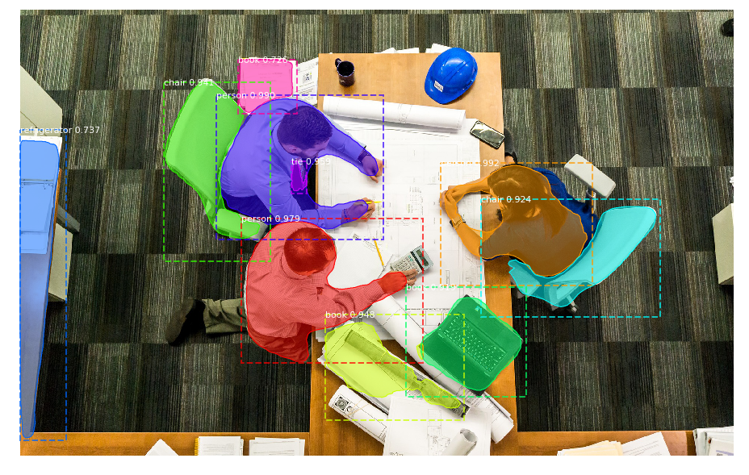
2
Progress
Test 4K Image – Park Juhyeon
Resolution is affected , but there is small difference between low resolution and high resolution

Slide 13
2
Progress
Additional Learning – Park Juhyeon
To Improve Performance of Segmentation,
We decide to train additional dataset
The existing structure is intact and changes only the weight file.
(It will be evaluate COCO evaluation code)

Slide 14
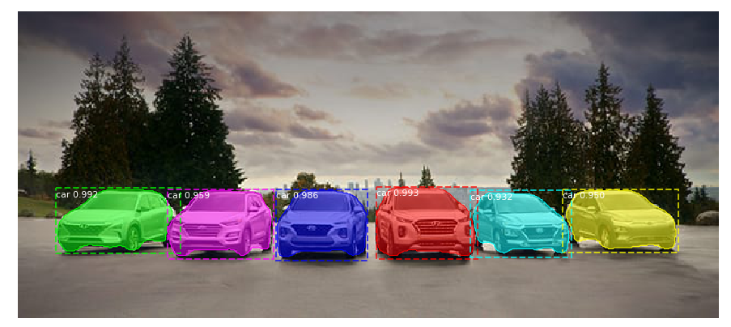
2
Progress
Additional Learning – Park Juhyeon
It is possible to finish with the current state, but will proceed for
BETTER RESULT

Slide 15
2.2
Lasso Function

Slide 16


2
Progress
Lasso Function - Hong Jin
Learning Model Modulation

Slide 17

2
Progress
Lasso Function - Hong Jin
Using QProcess
Pros : Easy to apply Python in QT
Cons : User must download Python
How about pyinstaller??

Slide 18
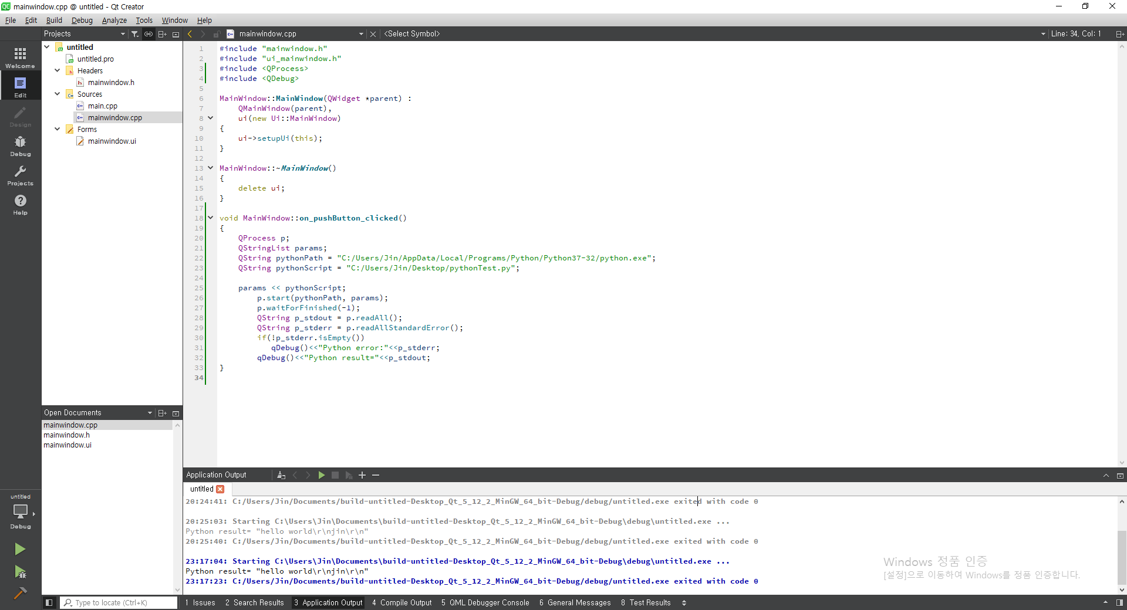
2
Progress
Lasso Function - Hong Jin
Test the usability of Python in QT

Slide 19
2
Progress
Lasso Function - Hong Jin
Learning Model
Input
Output

Slide 20
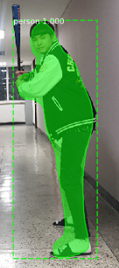
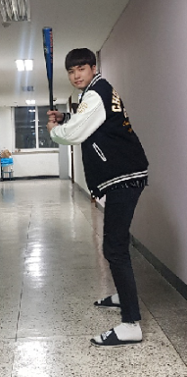
2
Progress
Lasso Function - Hong Jin
Current Progress – Modify functions
person
Input
Output

Slide 21
2
Progress
Lasso Function - Hong Jin
Trouble Shooting
Using a server to Run? (Solve)
- Consider server overload, Install in Local
How to save extracted parts only?
- Still in trouble

Slide 22
2.3
QT Basic UI

Slide 23
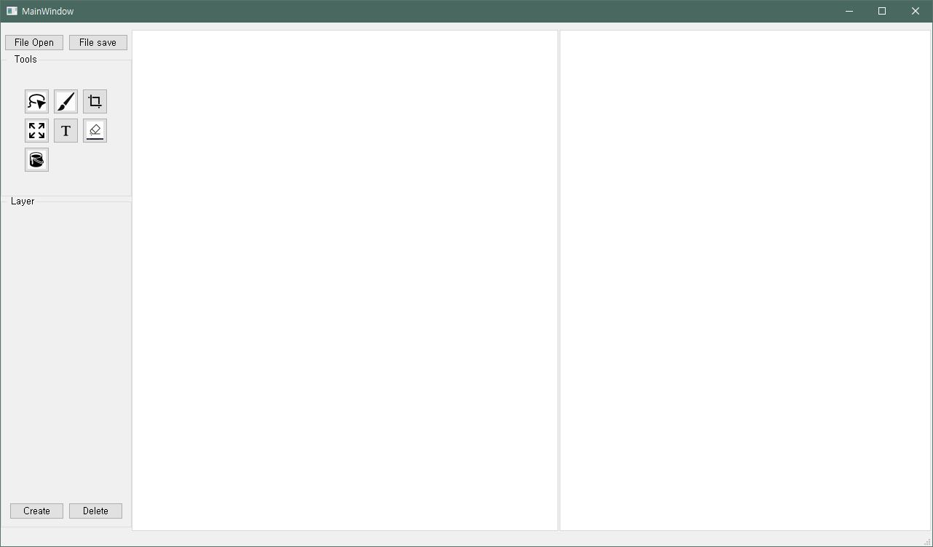
2
Progress
QT Basic UI – Heo Jeong Woo
Modify Main UI - Tools

Slide 24
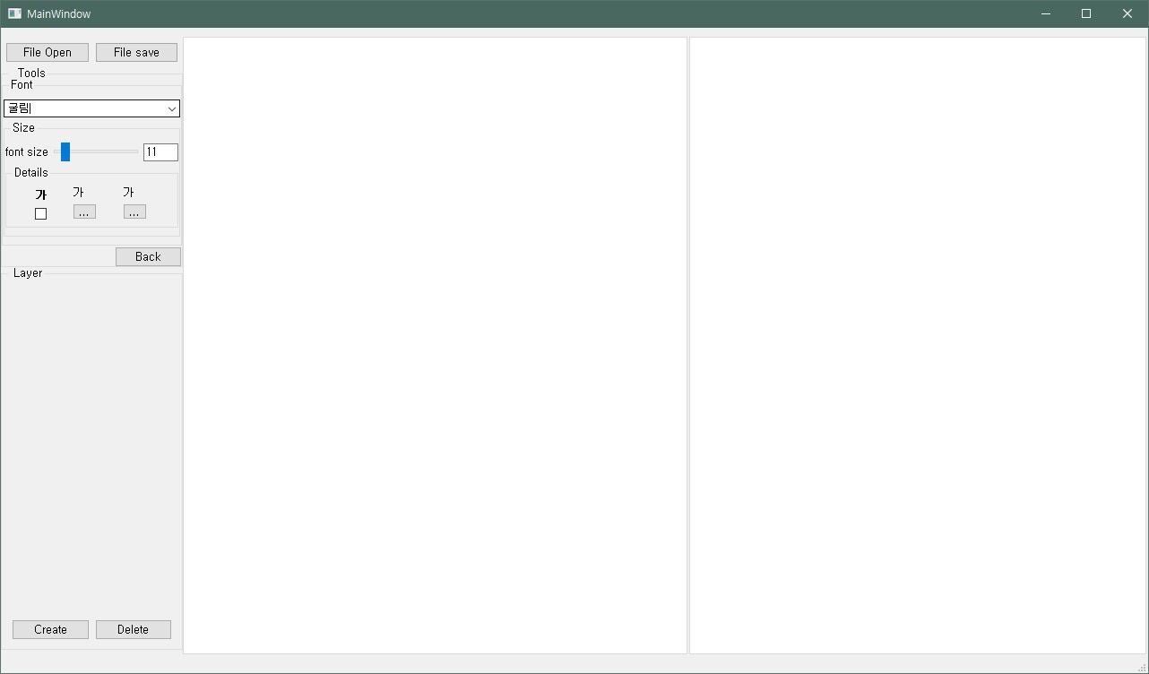
2
Progress
QT Basic UI – Heo Jeong Woo
Text Tool

Slide 25
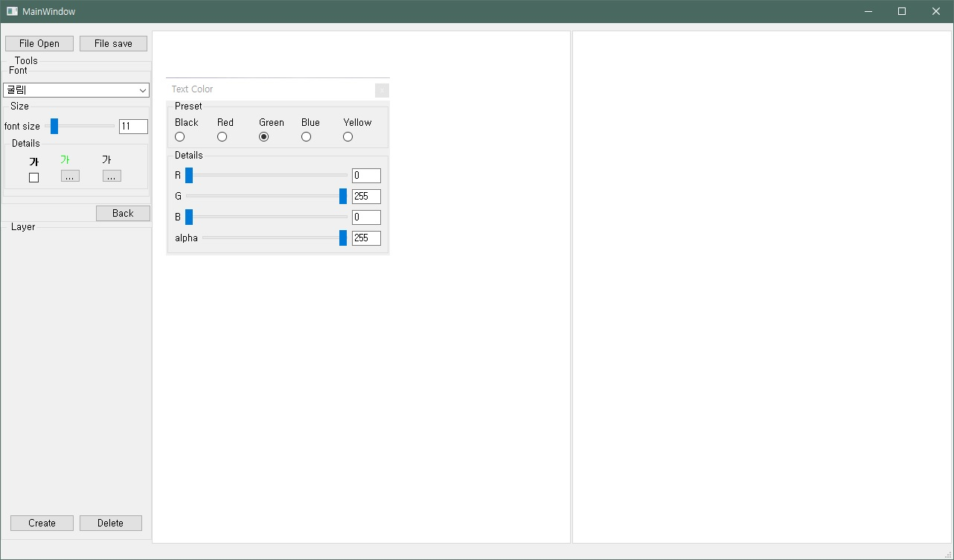
2
Progress
QT Basic UI – Heo Jeong Woo
Font Tools – Color

Slide 26
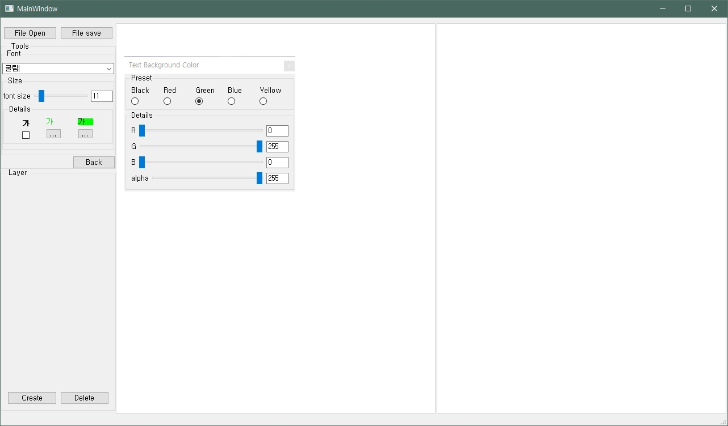
2
Progress
QT Basic UI – Heo Jeong Woo
Font Tools – Back Ground Color

Slide 27
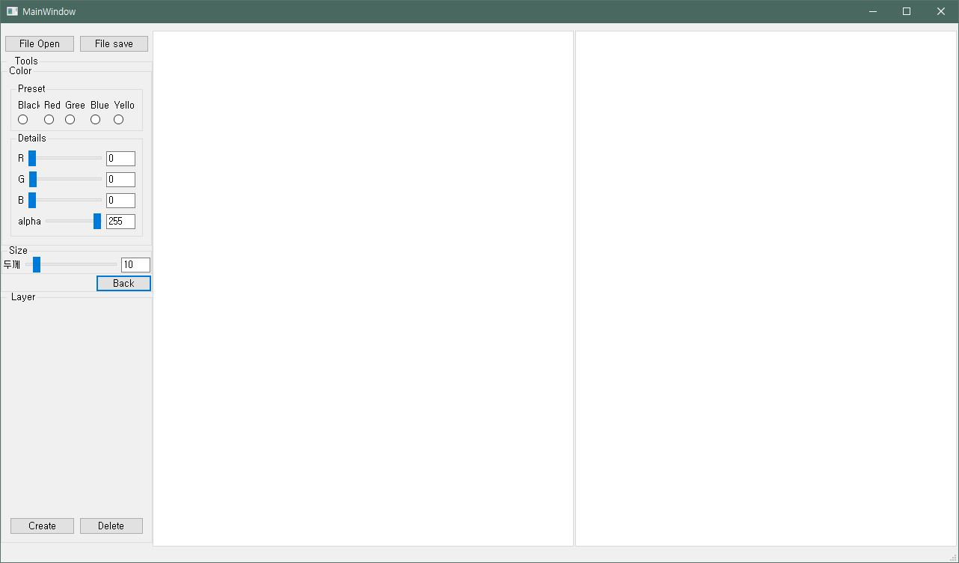
2
Progress
QT Basic UI – Heo Jeong Woo
Brush Tool

Slide 28
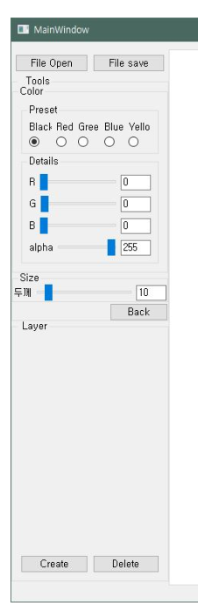
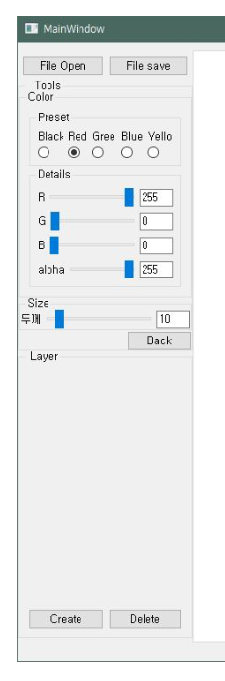
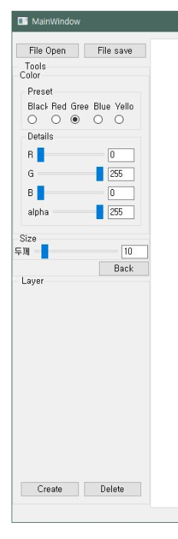
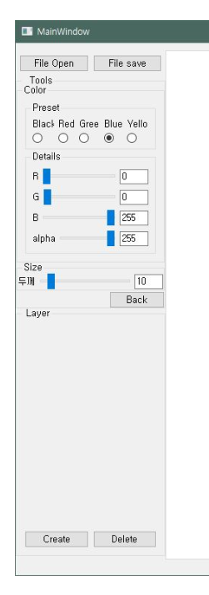
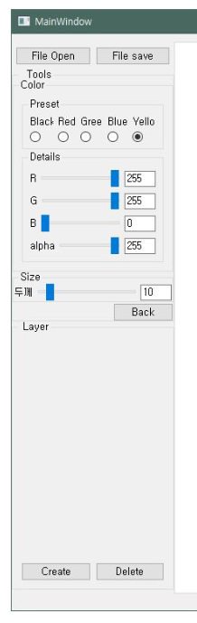
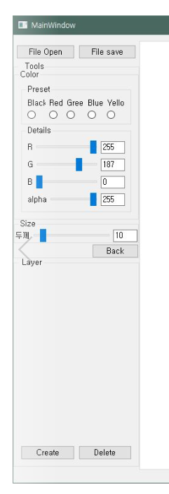
2
Progress
QT Basic UI – Heo Jeong Woo
Brush Tool – Radio Buttons

Slide 29
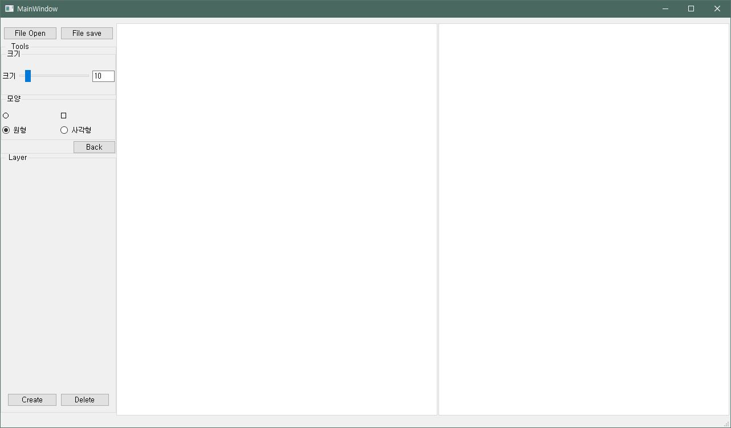
2
Progress
QT Basic UI – Heo Jeong Woo
Eraser Tool

Slide 30
2
Progress
QT Basic UI – Heo Jeong Woo
Eraser Tool

Slide 31
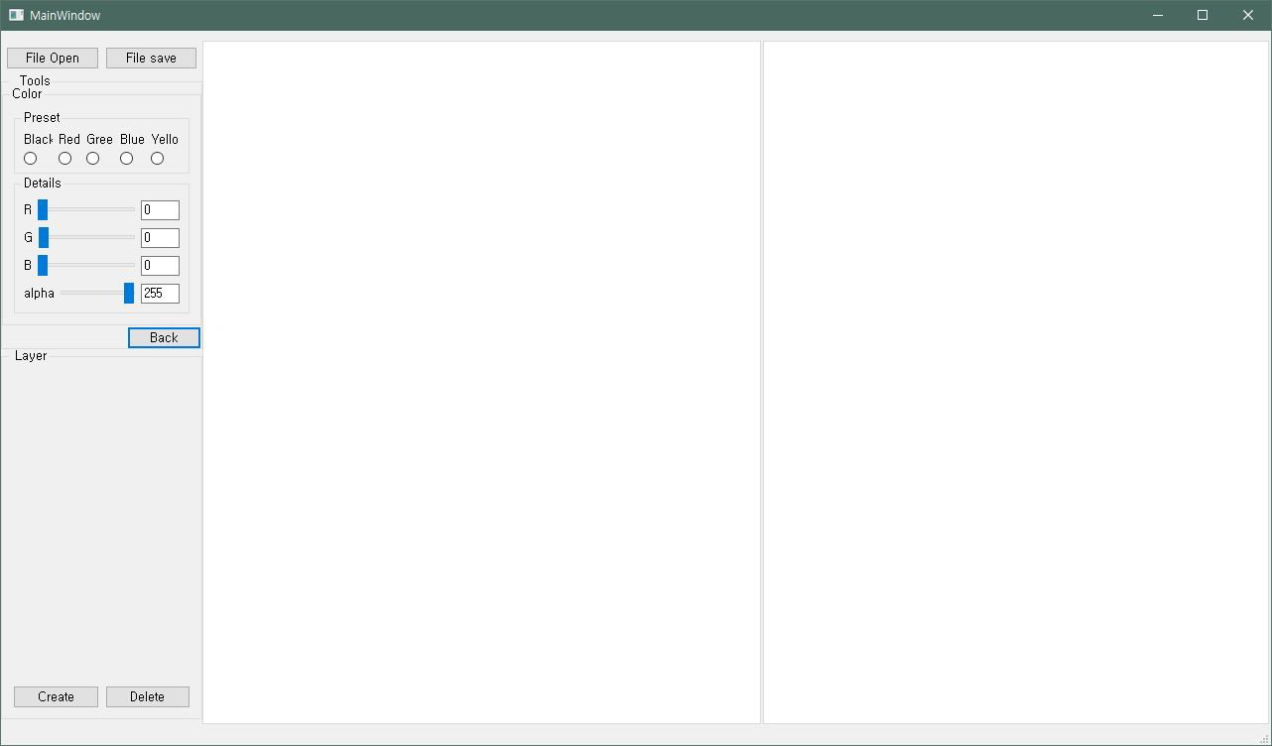
2
Progress
QT Basic UI – Heo Jeong Woo
Paint Tool

Slide 32
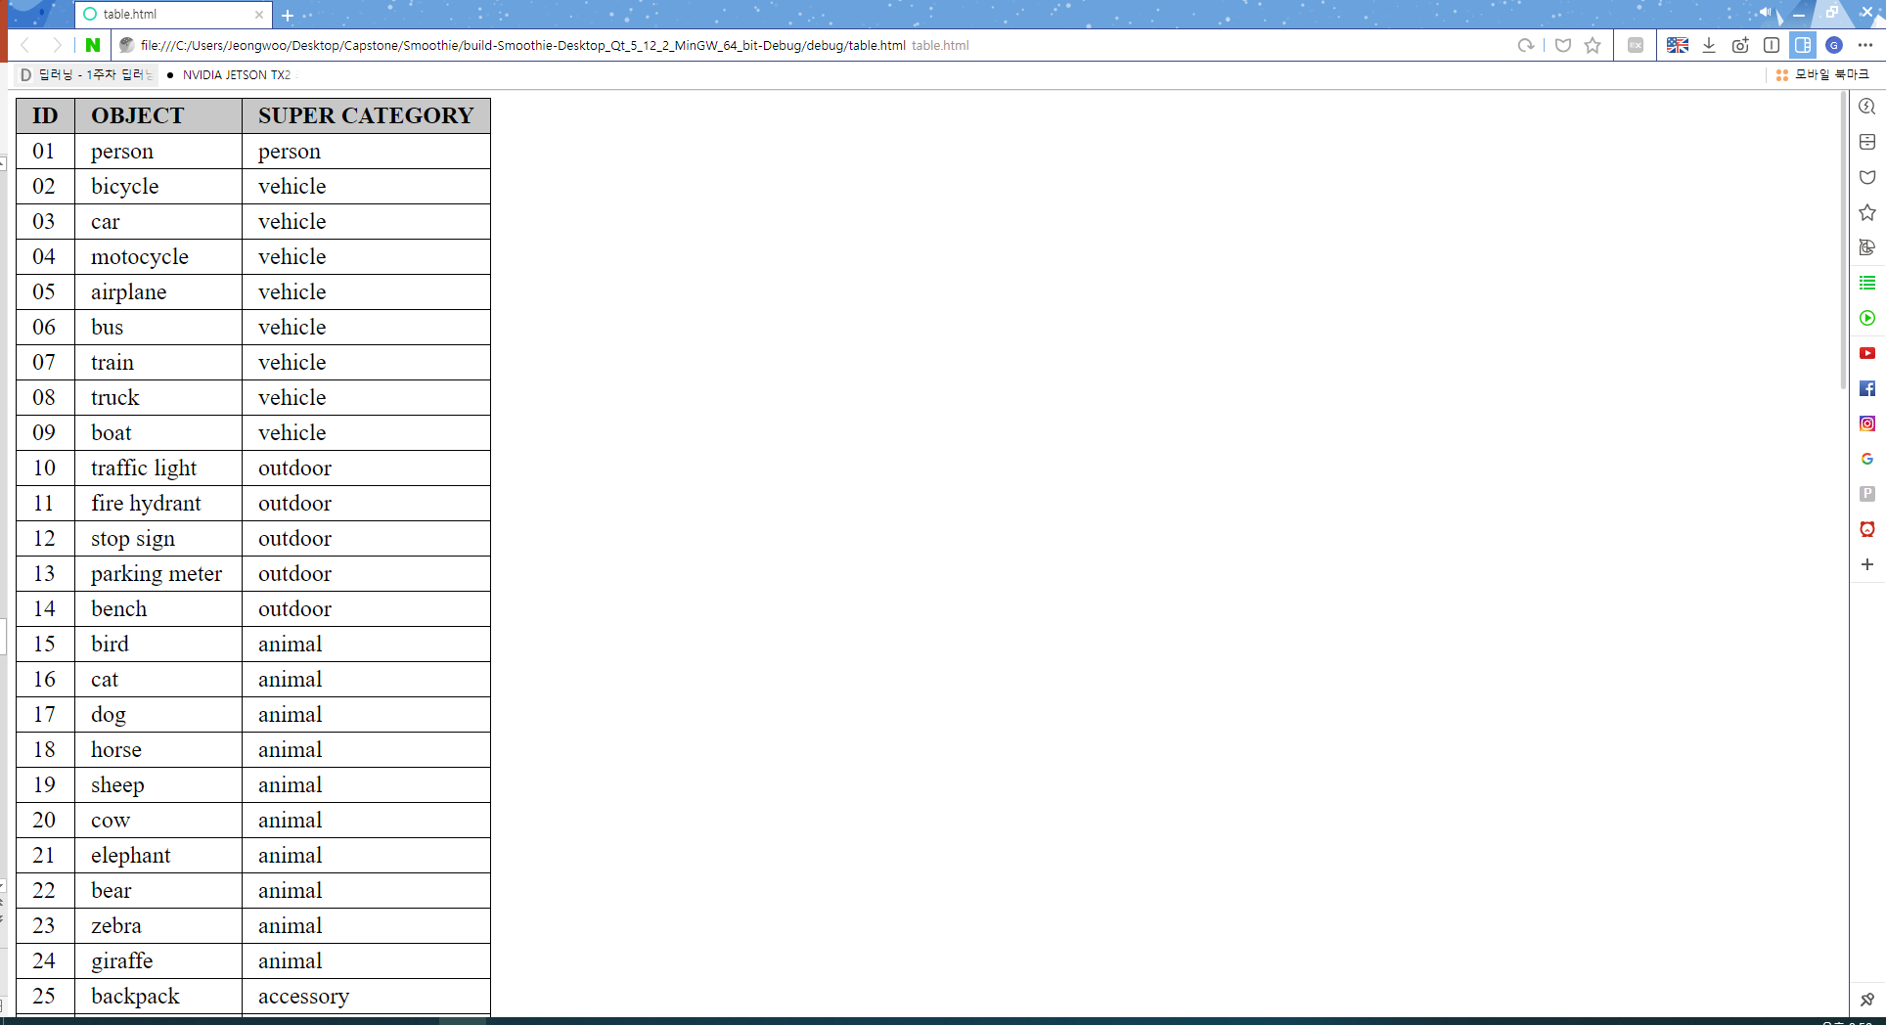
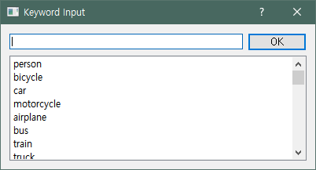
2
Progress
QT Basic UI – Heo Jeong Woo
Trouble Shooting
1. The radio button must be pressed one (Solve)
-> After disable Group Property attributes, We can make radio button not pressed.
2. Location of KeyWord Recommendation (Not Yet)
-> How to implement an existing ? Button when imported into the main window.
click

Slide 33
3.
Schedule

Slide 34
3
Schedule
 | March |  |  | April |  |  |  |  | May |  |  |  | June
Week | 11 | 18 | 25 | 1 | 8 | 15 | 22 | 29 | 6 | 13 | 20 | 27 | 3 | 10 | 17
Data survey
Collect Datasets
Detection Model
Segmentation Model
Lasso Function
QT basic UI
Prepare Midterm Demo
Function & QT Details
Test and Debugging
Prepare Final Demo
Writing manuals, report
Midterm Presentation
Midterm Exam
Final Presentation

Slide 35
3
Schedule
Progress | Park Juhyeon | Hong Jin | Heo Jung Woo
Already done | Content Acquisition & Data survey
 | Collect Initial Dataset & Implement Learning Model
This Week Proceeding | Test 4K file Image | Apply Python Model to QT | Basic UI
 | Collect Test Dataset | Lasso Function Modulation | Modify Basic Fucntion (Paint, Brush…)
 | Additional Learning | Modify Learning Fucntion

Slide 36
4.
Q&A

